Slide 1
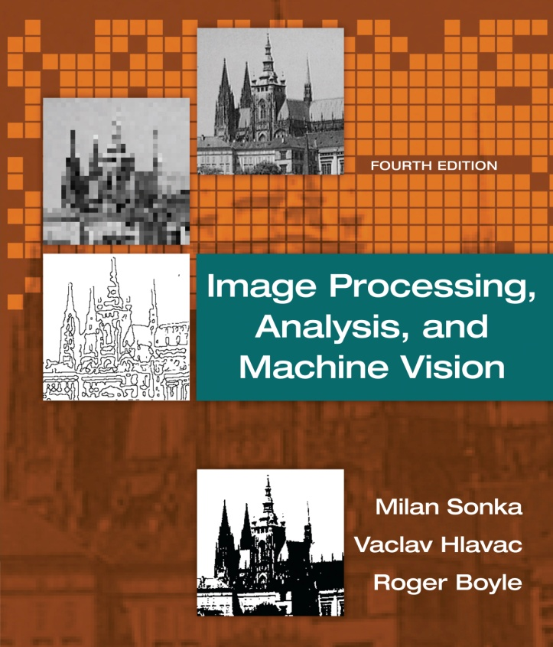

Chapter 6
Image Processing, Analysis, and Machine Vision, 4th Edition Sonka, Hlavac & Boyle
Segmentation I

Slide 2
Segmentation
Thresholding
Edge-based segmentation
Region-based segmentation
Matching
Evaluation issues in segmentation
Supervised evaluation
Unsupervised evaluation

Slide 3
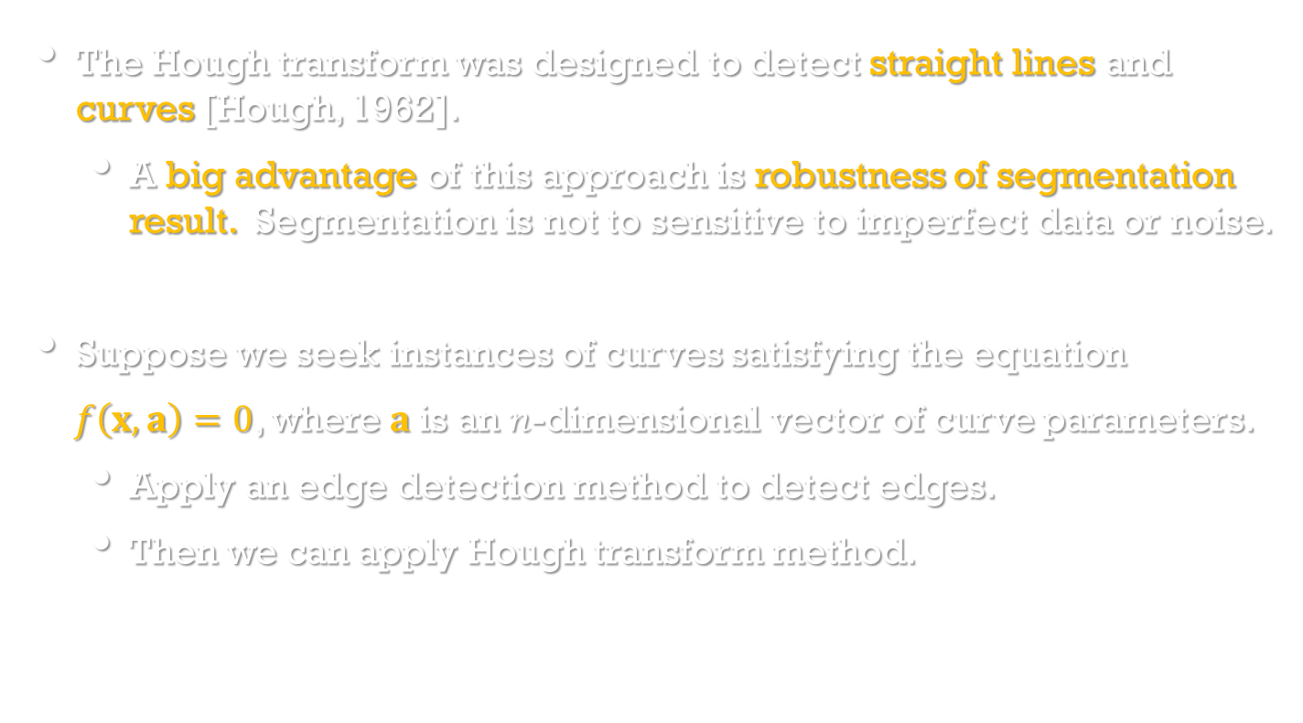
Hough transforms
Image Processing, Analysis, and Machine Vision, 4th Edition Sonka, Hlavac & Boyle
The Hough transform was designed to detect straight lines and curves [Hough, 1962].
A big advantage of this approach is robustness of segmentation result. Segmentation is not to sensitive to imperfect data or noise.
Suppose we seek instances of curves satisfying the equation
$f\left(x,a\right)=0$, where $a$is an $n$-dimensional vector of curve parameters.
Apply an edge detection method to detect edges.
Then we can apply Hough transform method.

Slide 4
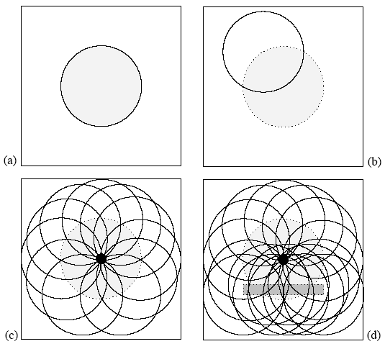
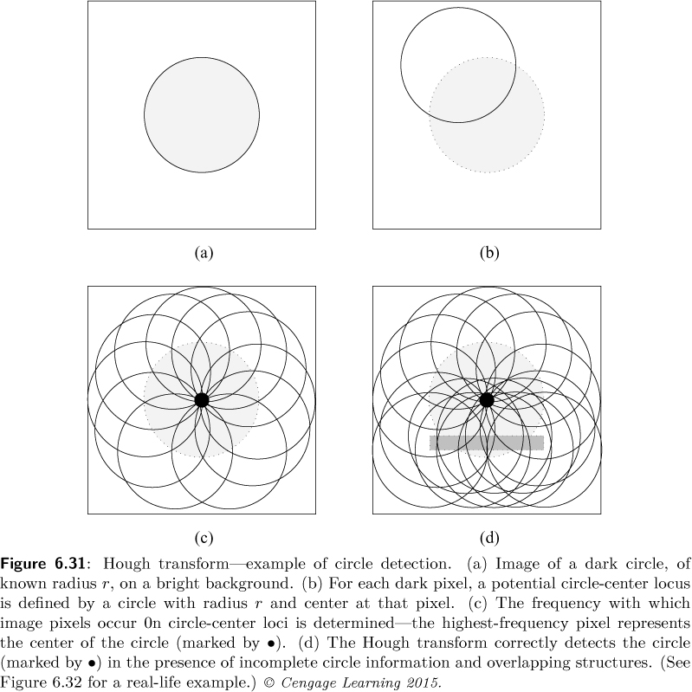
Image Processing, Analysis, and Machine Vision, 4th Edition Sonka, Hlavac & Boyle

Slide 5
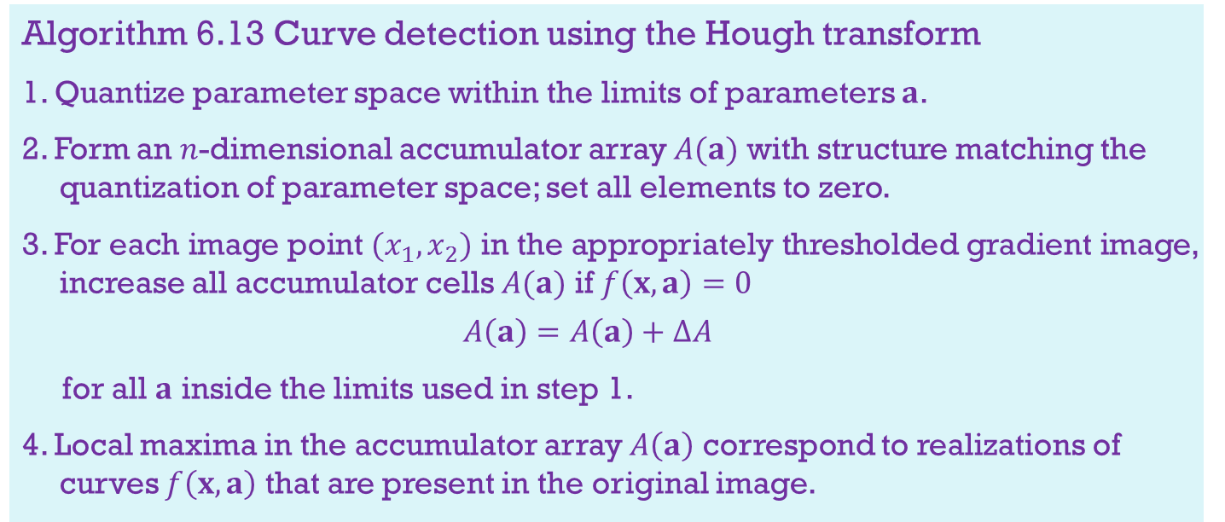
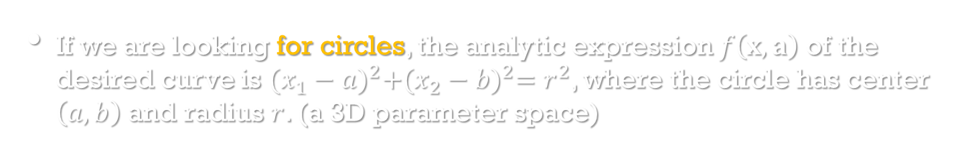
Hough transforms
Algorithm 6.13 Curve detection using the Hough transform
1. Quantize parameter space within the limits of parameters $a$.
2. Form an $n$-dimensional accumulator array $A(a)$ with structure matching the quantization of parameter space; set all elements to zero.
3. For each image point $(x_{1},x_{2})$ in the appropriately thresholded gradient image, increase all accumulator cells $A(a)$ if $f\left(x,a\right)=0$
$$A\left(a\right)=A\left(a\right)+∆A$$
for all $a$ inside the limits used in step 1.
4. Local maxima in the accumulator array $A\left(a\right)$ correspond to realizations of curves $f\left(x,a\right)$ that are present in the original image.
If we are looking for circles, the analytic expression $f\left(x,a\right)$ of the desired curve is ${(x_{1}−a)}^{2}+{(x_{2}−b)}^{2}=r^{2}$, where the circle has center $\left(a,b\right)$ and radius $r$. (a 3D parameter space)

Slide 6
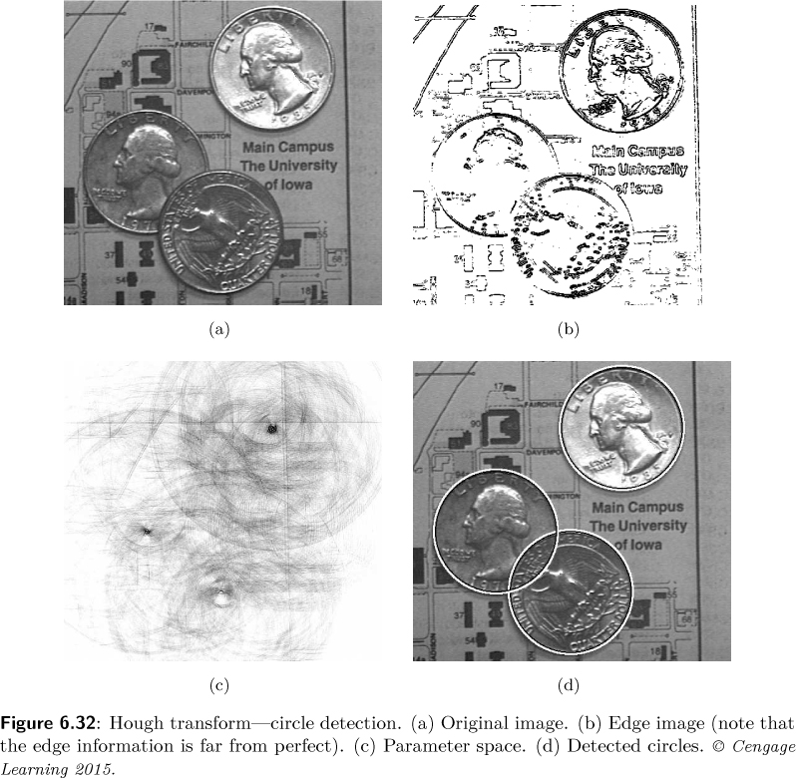
Image Processing, Analysis, and Machine Vision, 4th Edition Sonka, Hlavac & Boyle

Slide 7
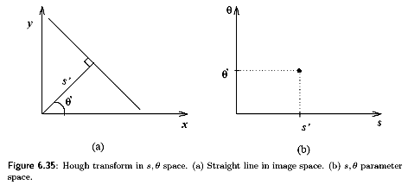
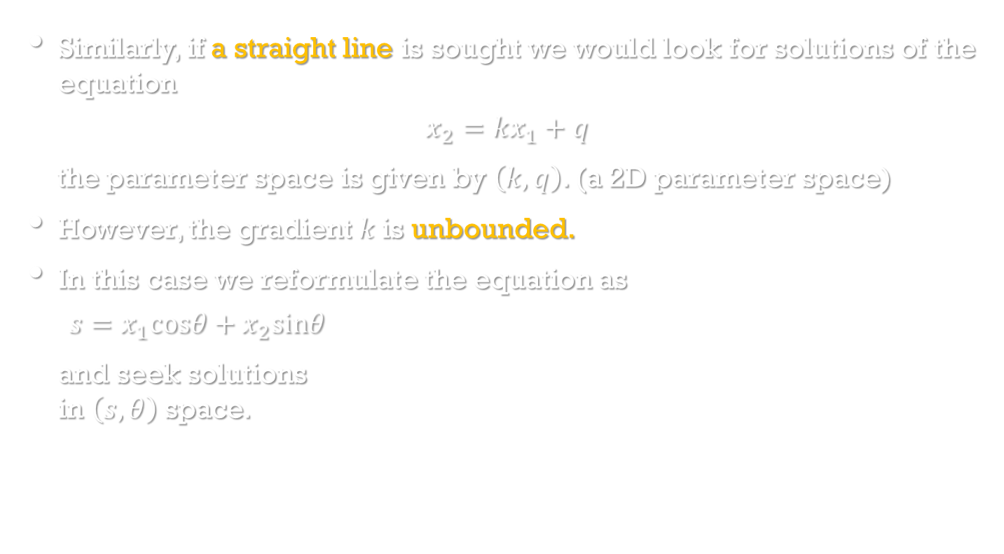
Hough transforms
Similarly, if a straight line is sought we would look for solutions of the equation
$$x_{2}=kx_{1}+q$$
the parameter space is given by $\left(k,q\right)$. (a 2D parameter space)
However, the gradient $k$is unbounded.
In this case we reformulate the equation as
$$s=x_{1}cosθ+x_{2}sinθ$$
and seek solutions in $\left(s,θ\right)$ space.

Slide 8
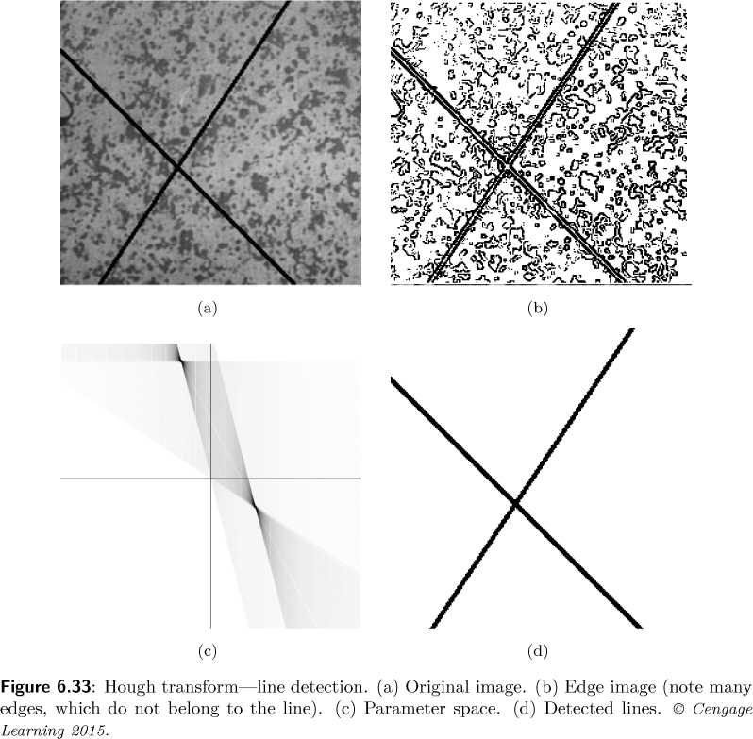
Image Processing, Analysis, and Machine Vision, 4th Edition Sonka, Hlavac & Boyle

Slide 9
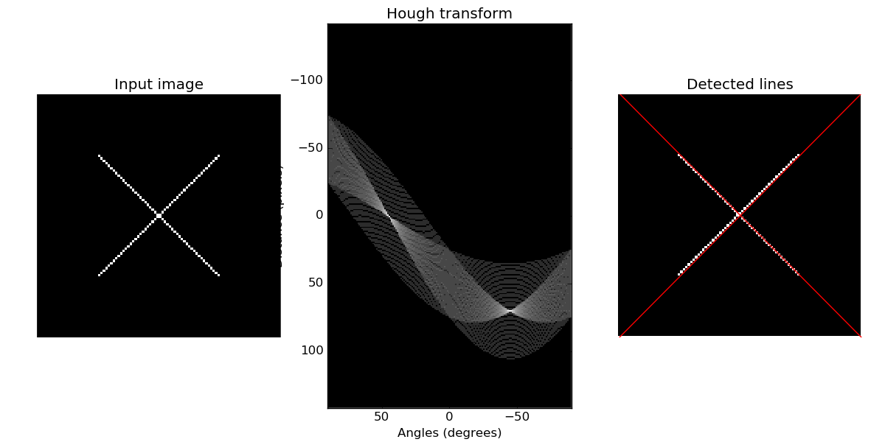
Hough transform
http://scikit-image.org/docs/dev/auto_examples/plot_line_hough_transform.html

Slide 10
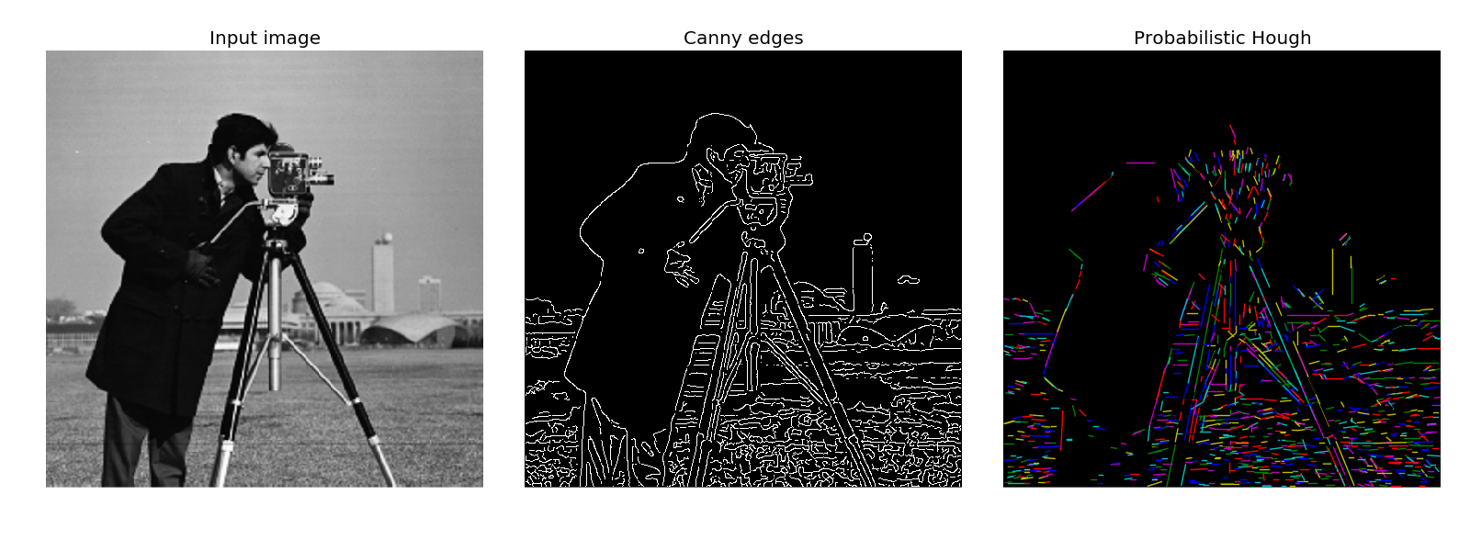
Hough transform
Progressive Probabilistic Hough Transform is based on the assumption that using a random subset of voting points give a good approximation to the actual result, and that lines can be extracted during the voting process by walking along connected components. This returns the beginning and end of each line segment, which is useful.
http://scikit-image.org/docs/dev/auto_examples/plot_line_hough_transform.html

Slide 11
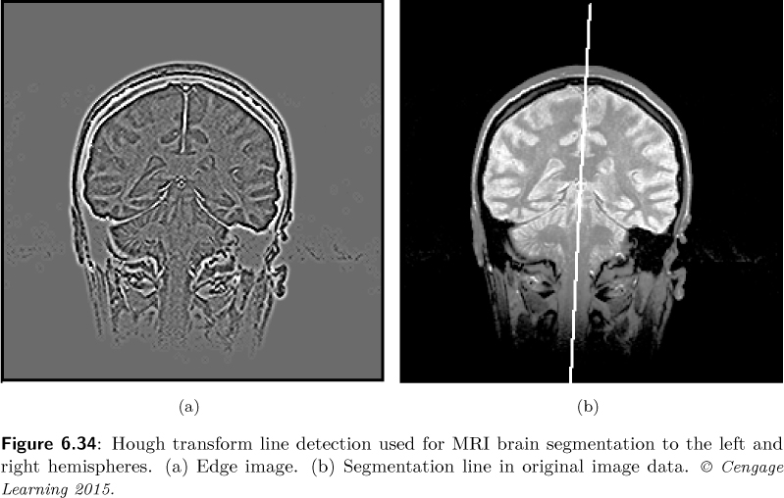
Hough transforms
Image Processing, Analysis, and Machine Vision, 4th Edition Sonka, Hlavac & Boyle
A practical example showing the segmentation of an MR image of the brain into the left and right hemispheres(大腦半球).

Slide 12
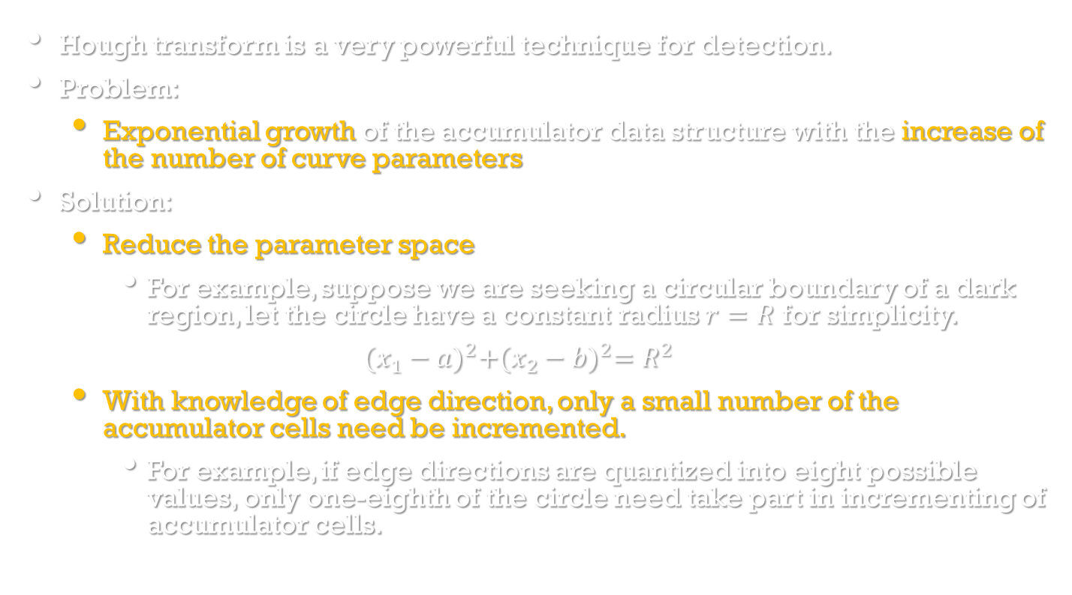
Hough transforms
Image Processing, Analysis, and Machine Vision, 4th Edition Sonka, Hlavac & Boyle
Hough transform is a very powerful technique for detection.
Problem:
Exponential growth of the accumulator data structure with the increase of the number of curve parameters
Solution:
Reduce the parameter space
For example, suppose we are seeking a circular boundary of a dark region, let the circle have a constant radius $r=R$ for simplicity.
$${(x_{1}−a)}^{2}+{(x_{2}−b)}^{2}=R^{2}$$
With knowledge of edge direction, only a small number of the accumulator cells need be incremented.
For example, if edge directions are quantized into eight possible values, only one-eighth of the circle need take part in incrementing of accumulator cells.

Slide 13
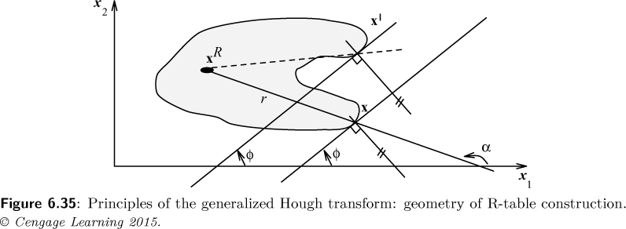
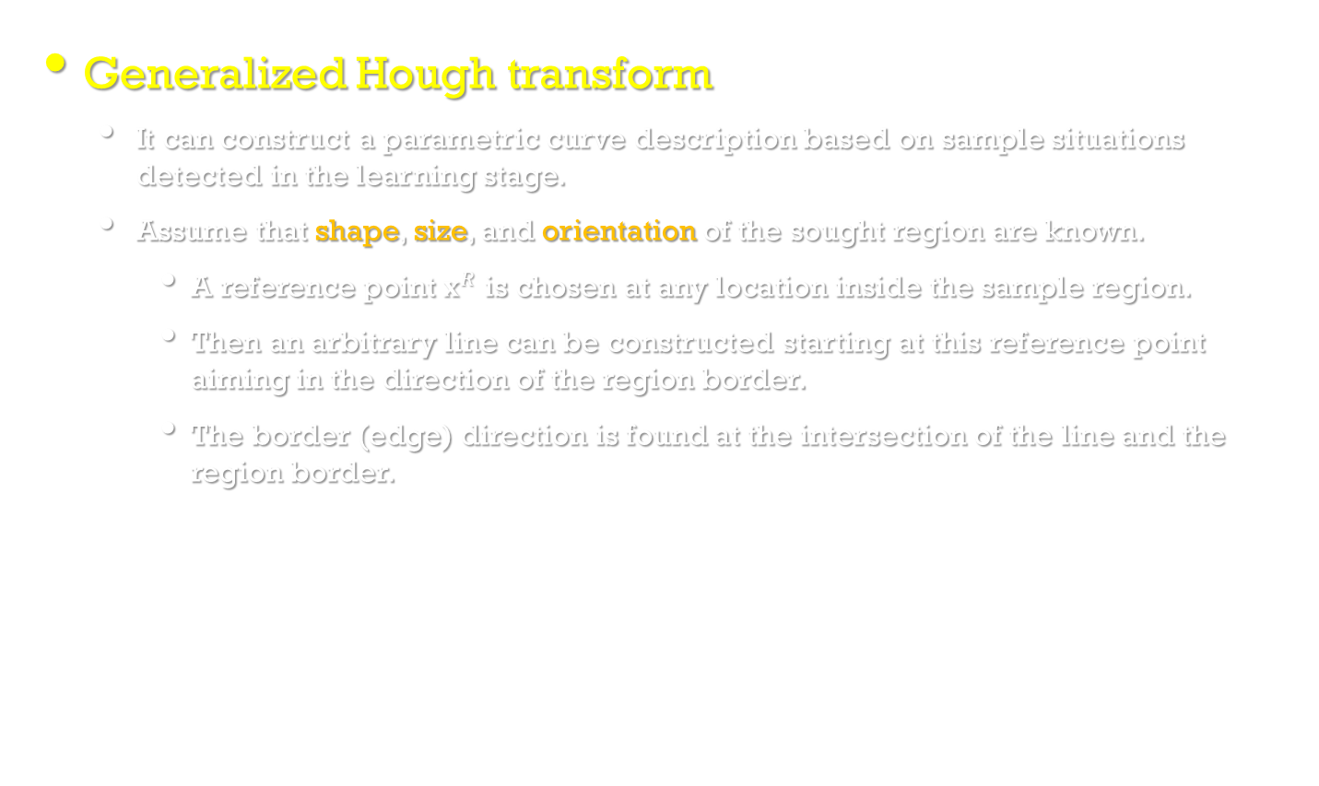
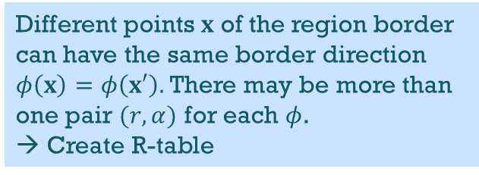
Generalized Hough transforms
Image Processing, Analysis, and Machine Vision, 4th Edition Sonka, Hlavac & Boyle
Generalized Hough transform
It can construct a parametric curve description based on sample situations detected in the learning stage.
Assume that shape, size, and orientation of the sought region are known.
A reference point $x^{R}$ is chosen at any location inside the sample region.
Then an arbitrary line can be constructed starting at this reference point aiming in the direction of the region border.
The border (edge) direction is found at the intersection of the line and the region border.
Different points $x$ of the region border can have the same border direction $φ\left(x\right)=φ\left(x′\right).$ There may be more than one pair $(r,α)$ for each $φ$.
→ Create R-table

Slide 14
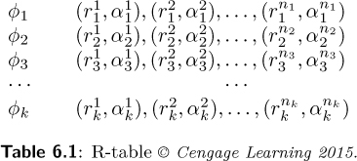
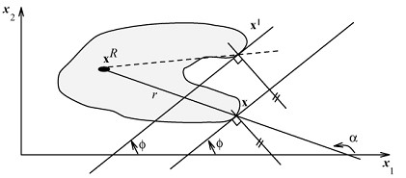
Generalized Hough transforms
Image Processing, Analysis, and Machine Vision, 4th Edition Sonka, Hlavac & Boyle
Generalized Hough transform
A reference table (R-table) is constructed and intersection parameters are stored as a function of the border direction at the intersection point.
Using different lines aimed from the reference point, all directions of the reference point to region borders and the border directions at the intersections can be found.
The resulting table can be ordered according to the border direction at the intersection points.

Slide 15
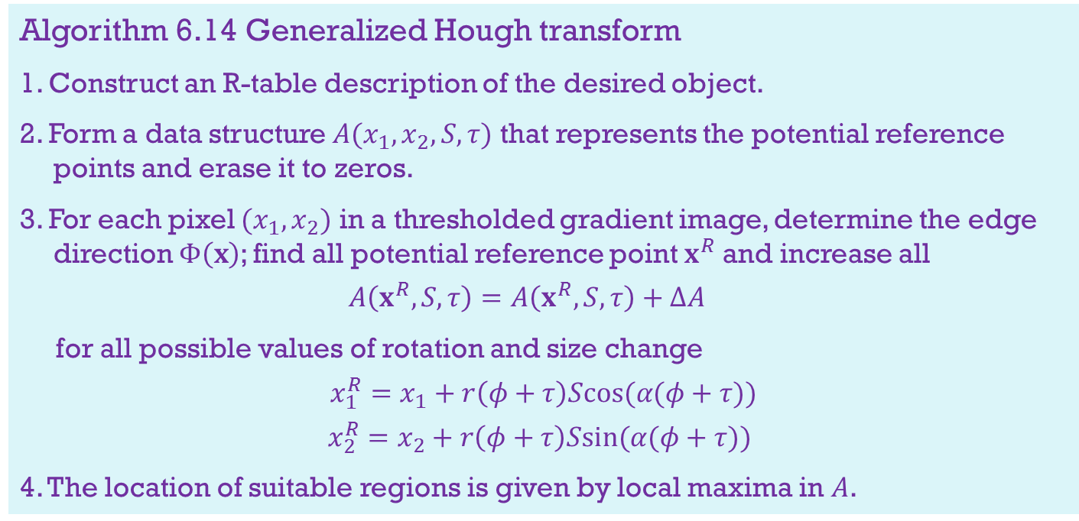
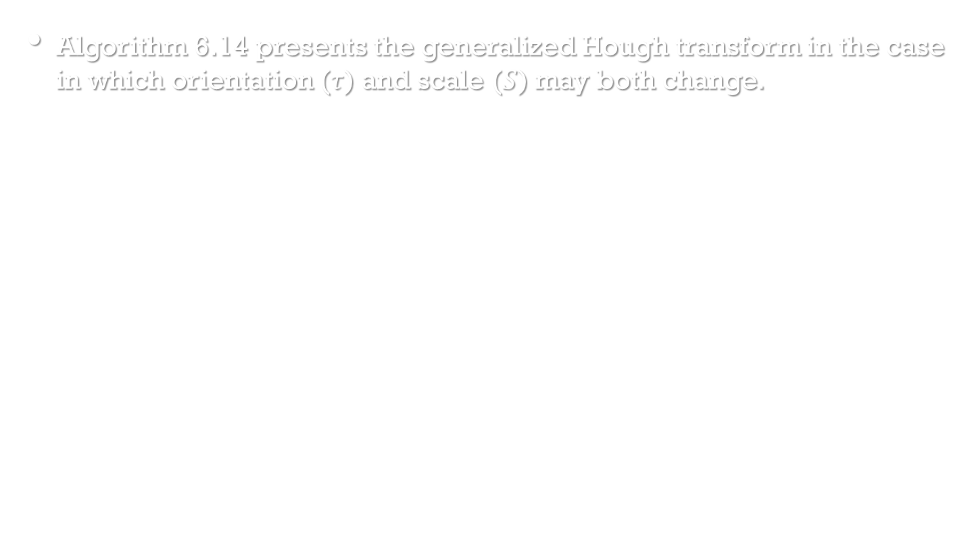
Generalized Hough transforms
Image Processing, Analysis, and Machine Vision, 4th Edition Sonka, Hlavac & Boyle
Algorithm 6.14 presents the generalized Hough transform in the case in which orientation ($τ$) and scale ($S$) may both change.
Algorithm 6.14 Generalized Hough transform
1. Construct an R-table description of the desired object.
2. Form a data structure $A(x_{1},x_{2},S,τ)$ that represents the potential reference points and erase it to zeros.
3. For each pixel $(x_{1},x_{2})$ in a thresholded gradient image, determine the edge direction $Φ\left(x\right)$; find all potential reference point $x^{R}$and increase all
$$A\left(x^{R}, S,τ\right)=A\left(x^{R}, S,τ\right)+∆A$$
for all possible values of rotation and size change
$$x_{1}^{R}=x_{1}+r\left(φ+τ\right)Scos(α(φ+τ))$$
$$x_{2}^{R}=x_{2}+r\left(φ+τ\right)Ssin(α(φ+τ))$$
4. The location of suitable regions is given by local maxima in $A$.

Slide 16
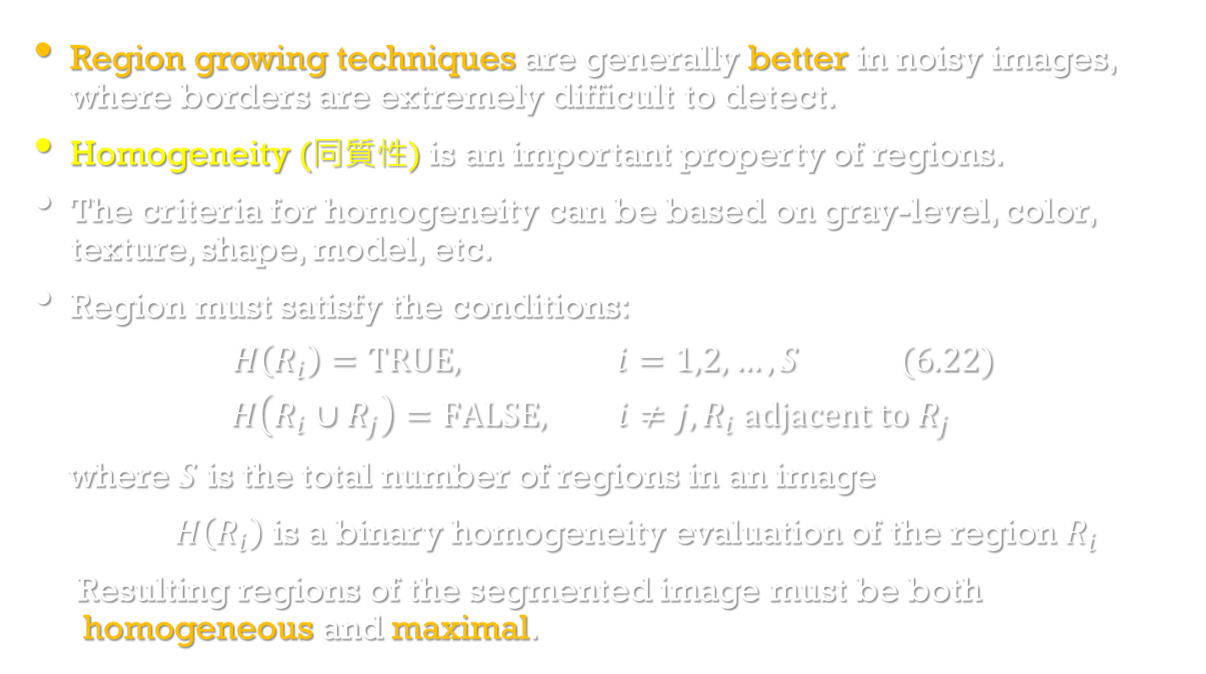
Region-based segmentation
Image Processing, Analysis, and Machine Vision, 4th Edition Sonka, Hlavac & Boyle
Region growing techniques are generally better in noisy images, where borders are extremely difficult to detect.
Homogeneity (同質性) is an important property of regions.
The criteria for homogeneity can be based on gray-level, color, texture, shape, model, etc.
Region must satisfy the conditions:
$$H\left(R_{i}\right)=TRUE, i=1,2,…,S (6.22)$$
$$H\left(R_{i}∪R_{j}\right)=FALSE, i≠j, R_{i} adjacent to R_{j}$$
where $S$ is the total number of regions in an image
$H\left(R_{i}\right)$ is a binary homogeneity evaluation of the region $R_{i}$
Resulting regions of the segmented image must be both homogeneous and maximal.

Slide 17
Region merging
Image Processing, Analysis, and Machine Vision, 4th Edition Sonka, Hlavac & Boyle
The most natural method of region growing is to begin the growth in the raw image data, each pixel representing a single region.
The result of region merging usually depends on the order in which regions are merged (so results may differ if segmentation begins in the upper left or lower right corner).
Algorithm 6.16 Region merging (outline)
1. Define some initialization to segment the image into many small regions satisfying condition (6.22).
2. Define a criterion for merging two adjacent regions.
3. Merge all adjacent regions satisfying the criterion.
If no two regions can be merged maintaining condition (6.22), stop.

Slide 18
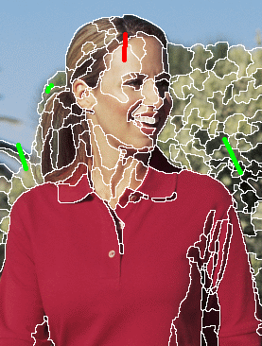
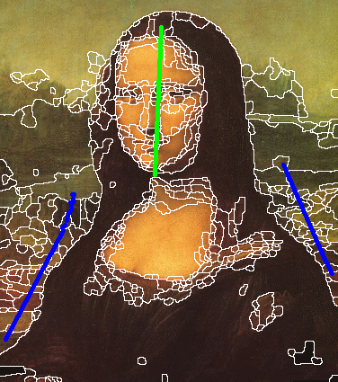
Region merging
http://www4.comp.polyu.edu.hk/~cslzhang/MSRM/PR_MSRM_website.htm

Slide 19
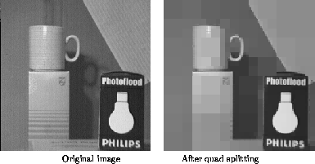
Region splitting
Image Processing, Analysis, and Machine Vision, 4th Edition Sonka, Hlavac & Boyle
Region splitting is the opposite of region merging.
It begins with the whole image represented as a single region.
Region splitting methods generally use similar homogeneity criteria as region merging methods.
Compare with region merging, region splitting does not result in the same segmentation even if the same homogeneity criteria are used. Why?
http://homepages.inf.ed.ac.uk/rbf/CVonline/LOCAL_COPIES/MARBLE/medium/segment/split.htm

Slide 20
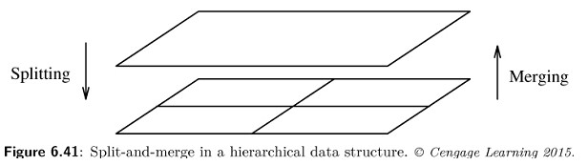
Splitting and merging
Image Processing, Analysis, and Machine Vision, 4th Edition Sonka, Hlavac & Boyle
A combination of splitting and merging may result in a method with the advantages of both.
Split-and-merge approaches work using pyramid image representations.
Regions are square shaped and correspond to elements of the appropriate pyramid level.
If any region in any pyramid level is not homogeneous, it is split into four subregions (this are elements of higher resolution at the level below).
If four regions exist at any pyramid level with approximately the same value of homogeneity measure, they are merged into a single region in an upper pyramid level.

Slide 21
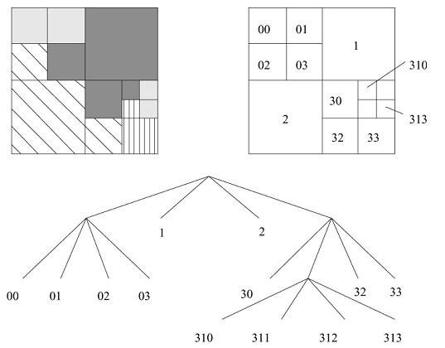
Splitting and merging
Image Processing, Analysis, and Machine Vision, 4th Edition Sonka, Hlavac & Boyle
Segmentation quadtree
The number of leaf nodes of the tree corresponds to the number of segmented regions after the segmentation process is over.
Drawback:
the square-region shape assumption

Slide 22
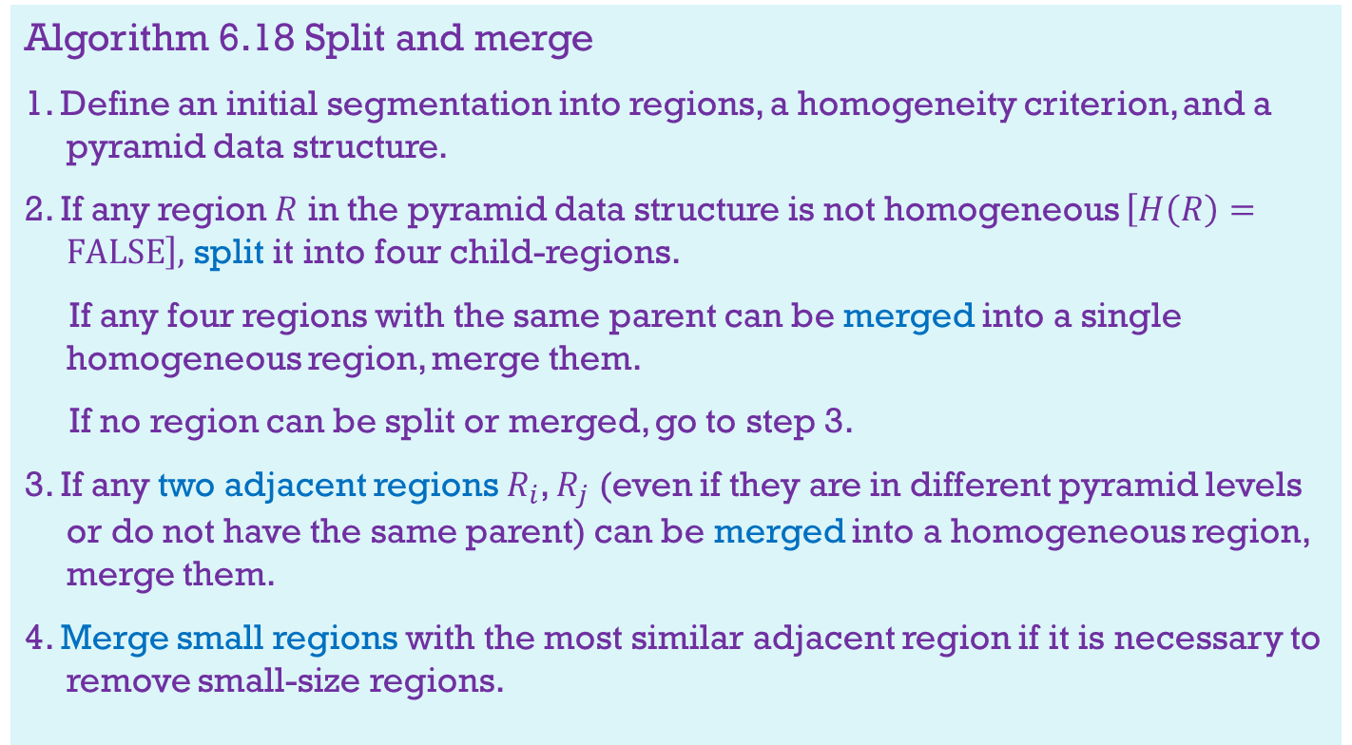
Splitting and merging
Algorithm 6.18 Split and merge
1. Define an initial segmentation into regions, a homogeneity criterion, and a pyramid data structure.
2. If any region $R$ in the pyramid data structure is not homogeneous $\left[H\left(R\right)=FALSE\right],$ split it into four child-regions.
If any four regions with the same parent can be merged into a single homogeneous region, merge them.
If no region can be split or merged, go to step 3.
3. If any two adjacent regions $R_{i}$, $R_{j}$ (even if they are in different pyramid levels or do not have the same parent) can be merged into a homogeneous region, merge them.
4. Merge small regions with the most similar adjacent region if it is necessary to remove small-size regions.

Slide 23
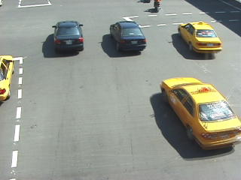

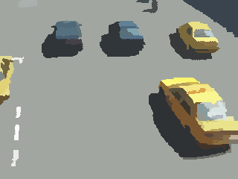
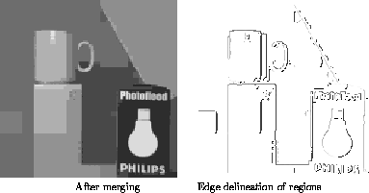
Splitting and merging
http://homepages.inf.ed.ac.uk/rbf/CVonline/LOCAL_COPIES/MARBLE/medium/segment/split.htm

Slide 24
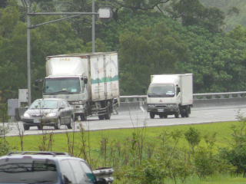
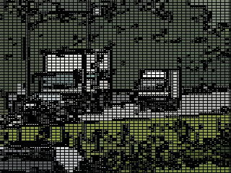
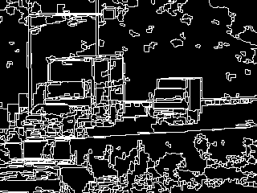
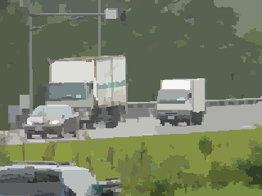

Slide 25
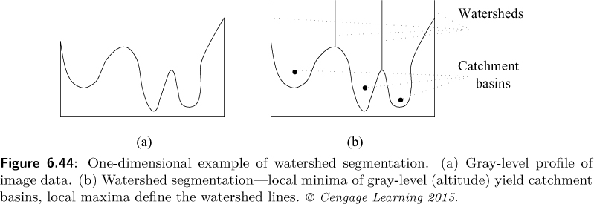
Watershed segmentation
Image Processing, Analysis, and Machine Vision, 4th Edition Sonka, Hlavac & Boyle
Image data may be interpreted as a topographic surface.
The concept of watersheds (分水嶺) and catchment basins (匯水盆地) are well known in topography(地形學).
Watershed lines divided individual catchment basins.

Slide 26
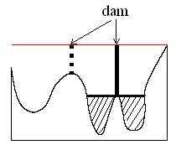
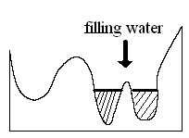
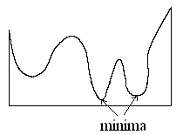
(Vincent and Soille, IEEE PAMI, 13(6), 1991)
Idea: The water fills all catchment basins.
If two basins are to merge, a dam is built all the way to the highest surface altitude and the dam (壩) represents the watershed line.
26

Slide 27
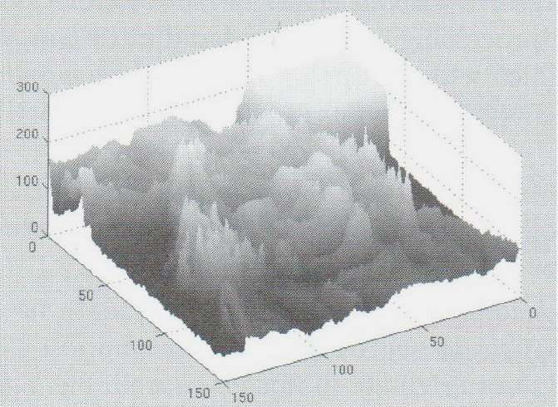
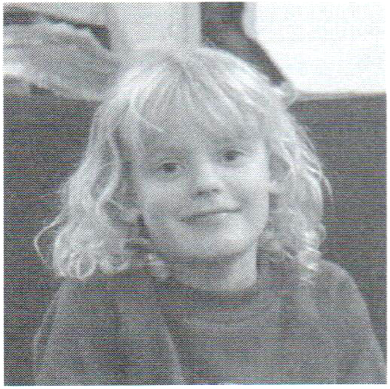
Watershed segmentation
Image Processing, Analysis, and Machine Vision, 4th Edition Sonka, Hlavac & Boyle
Figures 1.8 and 1.9 show that image data may be interpreted as a topographic graphic surface where the gradient image gray-levels represent altitudes (高度).
While the concept of watersheds and catchment basins is quite straightforward, development of algorithms for watershed segmentation is a complex task.

Slide 28
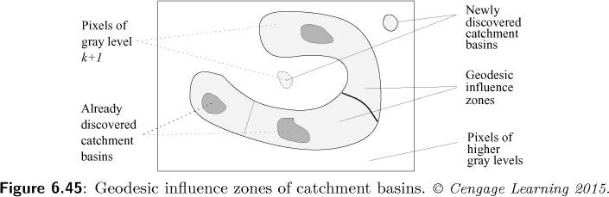
Watershed segmentation
Image Processing, Analysis, and Machine Vision, 4th Edition Sonka, Hlavac & Boyle
An efficient algorithm for such watershed segmentation was presented in [Vincent and Soille,1991].
It is based on sorting the pixels in increasing order of their gray values, flooding (泛濫) step consisting of a fast breadth-first scanning of all pixels in the order of their gray-levels.

Slide 29
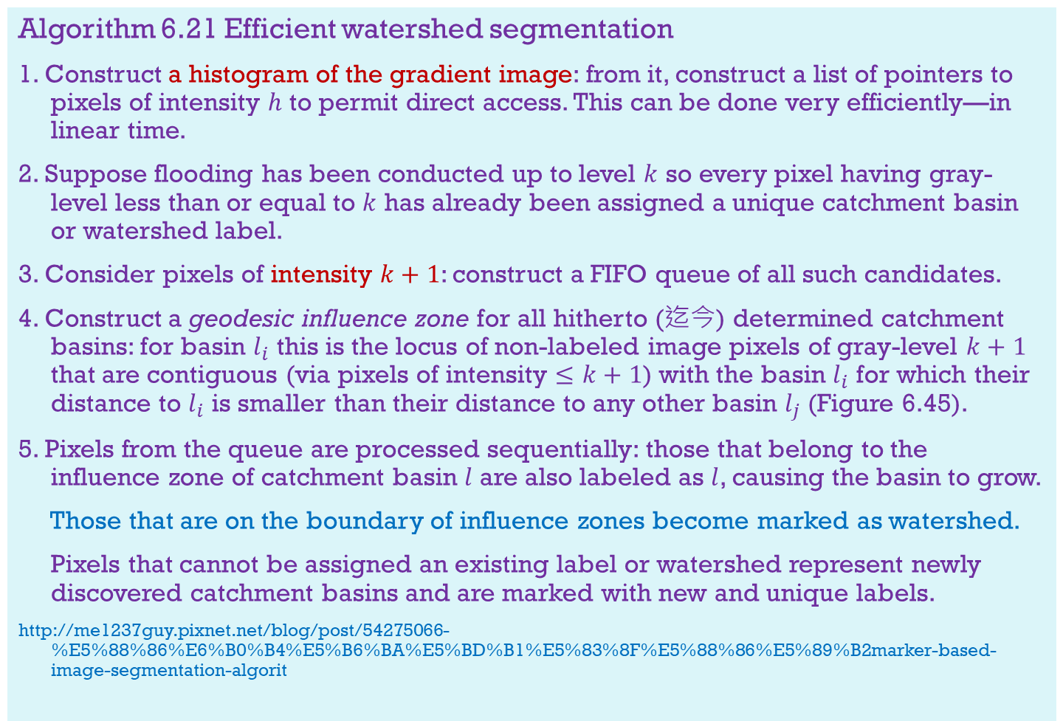
Algorithm 6.21 Efficient watershed segmentation
1. Construct a histogram of the gradient image: from it, construct a list of pointers to pixels of intensity $h$ to permit direct access. This can be done very efficiently—in linear time.
2. Suppose flooding has been conducted up to level $k$ so every pixel having gray-level less than or equal to $k$ has already been assigned a unique catchment basin or watershed label.
3. Consider pixels of intensity $k+1$: construct a FIFO queue of all such candidates.
4. Construct a geodesic influence zone for all hitherto (迄今) determined catchment basins: for basin $l_{i}$ this is the locus of non-labeled image pixels of gray-level $k+1$ that are contiguous (via pixels of intensity $≤k+1$) with the basin $l_{i}$ for which their distance to $l_{i}$ is smaller than their distance to any other basin $l_{j}$ (Figure 6.45).
5. Pixels from the queue are processed sequentially: those that belong to the influence zone of catchment basin $l$ are also labeled as $l$, causing the basin to grow.
Those that are on the boundary of influence zones become marked as watershed.
Pixels that cannot be assigned an existing label or watershed represent newly discovered catchment basins and are marked with new and unique labels.
http://me1237guy.pixnet.net/blog/post/54275066-%E5%88%86%E6%B0%B4%E5%B6%BA%E5%BD%B1%E5%83%8F%E5%88%86%E5%89%B2marker-based-image-segmentation-algorit

Slide 30
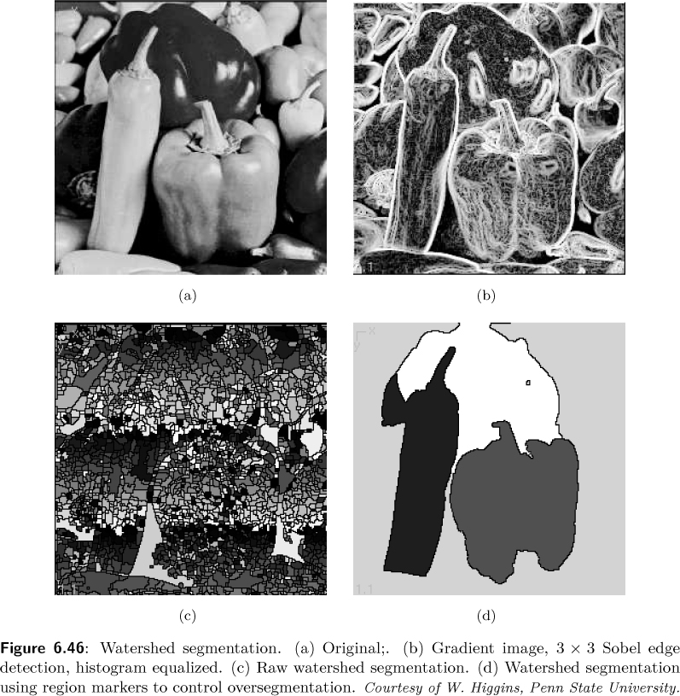
Image Processing, Analysis, and Machine Vision, 4th Edition Sonka, Hlavac & Boyle

Slide 31
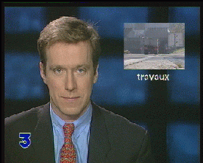
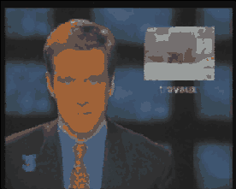
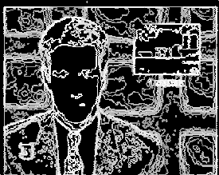


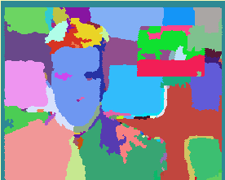
Color segmentation with hierarchical watershed
http://cmm.ensmp.fr/~demarty/CTI/segmentation_couleur_ang.html

Slide 32
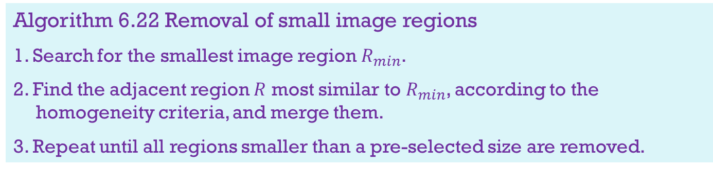
Region growing post-processing
Image Processing, Analysis, and Machine Vision, 4th Edition Sonka, Hlavac & Boyle
Image segmented by region growing methods often contain either too many regions (under-growing) or too few regions (over-growing).
Post-processors can improve classification result.
For example, combining region growing and edge detection
Simpler post-processors are based on general heuristics and decrease the number of small regions in a segmented image.
Algorithm 6.22 Removal of small image regions
1. Search for the smallest image region $R_{min}$.
2. Find the adjacent region $R$ most similar to $R_{min}$, according to the homogeneity criteria, and merge them.
3. Repeat until all regions smaller than a pre-selected size are removed.

Slide 33
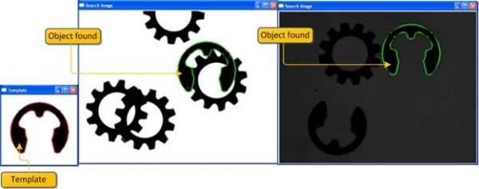
Matching
Image Processing, Analysis, and Machine Vision, 4th Edition Sonka, Hlavac & Boyle
Matching is a basic approach to segmentation that permits the location of known objects in an image, search for specific patterns, etc.
For example, template matching applied to OCR, face recognition,…
http://www.codeproject.com/Articles/99457/Edge-Based-Template-Matching

Slide 34

Template Matching
Image Processing, Analysis, and Machine Vision, 4th Edition Sonka, Hlavac & Boyle
Given a template $T$ of dimension $r_{T}×c_{T}$ and an image $I$, we will hold it at offsets $x=(x_{a},x_{b})$.
If the template fit perfectly we have
$$E\left(x\right)=\sum_{i=1}^{r_{T}}{\sum_{j=1}^{c_{T}}{{(T_{i,j}−I_{x_{a}+i,x_{b}+j})}^{2}}}=0$$
Further, local minima of $E\left(x\right)$ will give some indication of quality of template fit.
$$E\left(x\right)=\sum_{i=1}^{r_{T}}{\sum_{j=1}^{c_{T}}{{(T_{i,j}−I_{x_{a}+i,x_{b}+j})}^{2}}} \\ =\sum_{i=1}^{r_{T}}{\sum_{j=1}^{c_{T}}{{(T_{i,j})}^{2}}}−2\sum_{i=1}^{r_{T}}{\sum_{j=1}^{c_{T}}{T_{i,j}I_{x_{a}+i,x_{b}+j}}}+\sum_{i=1}^{r_{T}}{\sum_{j=1}^{c_{T}}{{(I_{x_{a}+i,x_{b}+j})}^{2}}}$$

Slide 35


Template Matching
Image Processing, Analysis, and Machine Vision, 4th Edition Sonka, Hlavac & Boyle
$$E\left(x\right)=\sum_{i=1}^{r_{T}}{\sum_{j=1}^{c_{T}}{{(T_{i,j})}^{2}}}−2\sum_{i=1}^{r_{T}}{\sum_{j=1}^{c_{T}}{T_{i,j}I_{x_{a}+i,x_{b}+j}}}+\sum_{i=1}^{r_{T}}{\sum_{j=1}^{c_{T}}{{(I_{x_{a}+i,x_{b}+j})}^{2}}}$$
Template matching may thus be performed by maximizing the correlation expression
$${Corr}_{T}\left(x\right)=\sum_{i=1}^{r_{T}}{\sum_{j=1}^{c_{T}}{T_{i,j}I_{x_{a}+i,x_{b}+j}}}$$

Slide 36


Template Matching
Image Processing, Analysis, and Machine Vision, 4th Edition Sonka, Hlavac & Boyle
$$E\left(x\right)=\sum_{i=1}^{r_{T}}{\sum_{j=1}^{c_{T}}{{(T_{i,j})}^{2}}}−2\sum_{i=1}^{r_{T}}{\sum_{j=1}^{c_{T}}{T_{i,j}I_{x_{a}+i,x_{b}+j}}}+\sum_{i=1}^{r_{T}}{\sum_{j=1}^{c_{T}}{{(I_{x_{a}+i,x_{b}+j})}^{2}}}$$
An alternative criterion for the same idea to minimize $E$ might be to maximize $C\left(x\right)$.
$$C\left(x\right)=\frac{1}{1+E\left(x\right)}$$
PS. For example, $E\left(x\right)=9−2×7+7=2$; $C\left(x\right)=\frac{1}{1+2}=\frac{1}{3}$

Slide 37

Template Matching
Image Processing, Analysis, and Machine Vision, 4th Edition Sonka, Hlavac & Boyle
Continuous edge gradient-based template matching for articulated objects
http://cgvr.cs.uni-bremen.de/publications.shtml

Slide 38
Template Matching
Image Processing, Analysis, and Machine Vision, 4th Edition Sonka, Hlavac & Boyle
Control strategies of templating
Template-based segmentation is time consuming even in the simplest cases.
The sequence of match tests must be data driven.
Speed improvement
Testing of image locations with a high probability, not necessary to test all possible pattern locations
Detect mismatch before all the corresponding pixels have been tested

Slide 39
Evaluation issues in segmentation
Image Processing, Analysis, and Machine Vision, 4th Edition Sonka, Hlavac & Boyle
Evaluating segmentations raises two problems.
How do we determine what is ‘right’, in order to compare a segmentation with reality?
What do we measure? And how do we measure it?
Evaluation methods
Supervised evaluation
Unsupervised evaluation

Slide 40

Evaluation issues in segmentation
Image Processing, Analysis, and Machine Vision, 4th Edition Sonka, Hlavac & Boyle
Supervised evaluation
Assumption: the ‘right’ answer (ground truth) is known
However, the ‘truth’ is often far from clear.
For example,

Slide 41




Evaluation issues in segmentation
Image Processing, Analysis, and Machine Vision, 4th Edition Sonka, Hlavac & Boyle
Supervised evaluation
Misclassfied area—mutual overlap
The mutual overlap (Dice evaluation) is based on computing the area of overlap between ground truth and a segmented region.
The area is normalized to the total area of the two defining regions.
If $A_{1}$ is the area of the segmented region, $A_{2}$ is the area of ground truth, $MO$ is the area of their mutual overlap, then the mutual overlap is defined as
$$M_{MO}=\frac{2MO}{A_{1}+A_{2}}$$
$$A_{1}$$
$$A_{2}$$

Slide 42

Evaluation issues in segmentation
Image Processing, Analysis, and Machine Vision, 4th Edition Sonka, Hlavac & Boyle
Border positioning errors (Method 1)
Considering Euclidean distance between segmented and ground truth pixels.
Hausdorff measure between two sets:
The Hausdorff distance between two sets $A$ and $B$ is computed by finding the minimum distance from each element of one to some element of the other, and then finding the maximum such.
$$h\left(A,B\right)=\max_{a∈A}\left(\min_{b∈B}{d\left(a,b\right)}\right)$$
where $d(a,b)$ is some suitable distance metric, commonly the Euclidean metric.
PS. 郝斯多夫距離(Hausdorff distance)量度度量空間中 緊子集(閉合且有界之集合)之間的距離。
由 Rocchini - 自己的作品, CC BY 3.0, https://commons.wikimedia.org/w/index.php?curid=2918812

Slide 43

Evaluation issues in segmentation
Image Processing, Analysis, and Machine Vision, 4th Edition Sonka, Hlavac & Boyle
Border positioning errors (Method 1)
Hausdorff measure
$$h(A,B)=\max_{a∈A}\left(\min_{b∈B}{d(a,b)}\right)$$
Hausdorff distance is oriented (asymmetric).
$$h(A,B)≠h(B,A)$$
A general definition of the Hausdorff distance between two sets is
$$H(A,B)=max⁡(h\left(A,B\right),h(B,A))$$
$H(A,B)$ has been adapted as an evaluation measure for the quality of segmentation results, where $A$ is the pixels of a ground truth region, and $B$ the pixels of a segmented region.

Slide 44


Evaluation issues in segmentation
Image Processing, Analysis, and Machine Vision, 4th Edition Sonka, Hlavac & Boyle
Border positioning errors (Method 2)
Consider only boundary pixel
Local border positioning errors are determined for each point of the segmented borders as a directional distance between pairs of point, the first being on the computer-determined border and the second on the ground truth.
Border positioning errors are usually averaged for the entire length of the segmented border and reported as mean $±$ standard deviation.

Slide 45
Evaluation issues in segmentation
Image Processing, Analysis, and Machine Vision, 4th Edition Sonka, Hlavac & Boyle
Border positioning errors (Methods 3, 4, …)
Other statistics might assist in assessing different aspects of the segmentation performance.
For example, signed and/or unsigned mean border positioning errors, maximum border positioning errors, and/or root-mean-square surface positioning errors are typically computed.

Slide 46

Evaluation issues in segmentation
Image Processing, Analysis, and Machine Vision, 4th Edition Sonka, Hlavac & Boyle
Unsupervised evaluation
Unsupervised approaches quantify quality of image segmentation without knowledge of ground truth.
Certain assumptions are made about a ‘good segmentation’ and these are either verified or not from the presented data.
A simple example is the inter-region dissimilarity criterion, which assumes that a good segmentation produces regions of uniform intensity with high contrast along borders.
If a gray-scale image contains an object with average intensity level $f_{O}$, and the average intensity of the local background is $f_{b}$, the measure $M$ can be defined as
$$M=\frac{|f_{O}−f_{b}|}{f_{O}+f_{b}}$$

